Slide 1
Applying and Evaluating
“The Agree Predictor: A Mechanism of Reducing Negative Branch History Interference”
Aryan Gupta
Allen Uta
Christopher Evans
George Pollard
Sani Patel

Slide 2
Introduction and Motivation
Paper of Focus is “The Agree Predictor: A Mechanism of Reducing Negative Branch History Interference” by Eric Sprangle, Robert S. Chappell, Mitch Alsup, and Yale N. Patt
Main issue is negative branch interference
New branch predictor implementation to resolve this issue
Many possible improvements to methodology of their simulation experiments
Number of base predictors
One-Level
Two-Level Global
Two-Level Local
Gshare
Location of bit values used to determine PHT entries
Starting Address Bit Location of 0, 7, and 14

Slide 3
Branch Interference Types
Three types of interference
Negative
The branch would have had the correct prediction, but due to the interference of the previous branch, it was a misprediction.
Neutral
The branch would have had the same prediction regardless if the interference was present or not.
Positive
The branch would have had a misprediction, but due to the interference of the previous branch, it was a correct prediction.

Slide 4
Branch Interference Example
Example:
Two branches consistently use the same entry in the PHT
These branches are Branch 1 and Branch 2
Branch 1 is always taken
Branch 2 varies between taken and not taken
Negative
Branch 2 Correct Prediction: Not Taken
Branch 2 Current Prediction: Not Taken
Branch 1 Changed PHT entry to predict Taken
Branch 2 Current Prediction: Taken
Branch 2 Misprediction occurs
Neutral
Positive

Slide 5
Branch Interference Example
Example:
Two branches consistently use the same entry in the PHT
These branches are Branch 1 and Branch 2
Branch 1 is always taken
Branch 2 varies between taken and not taken
Negative
Neutral
Branch 2 Correct Prediction: Taken
Branch 2 Current Prediction: Taken
Branch 1 reinforces PHT entry to predict Taken
Branch 2 Current Prediction: Taken
Branch 2 Correct Prediction occurs
Positive

Slide 6
Branch Interference Example
Example:
Two branches consistently use the same entry in the PHT
These branches are Branch 1 and Branch 2
Branch 1 is always taken
Branch 2 varies between taken and not taken
Negative
Neutral
Positive
Branch 2 Correct Prediction: Taken
Branch 2 Current Prediction: Not Taken
Branch 1 Changed PHT entry to predict Taken
Branch 2 Current Prediction: Taken
Branch 2 Correct Prediction occurs

Slide 7
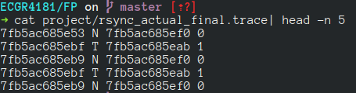
Trace
The trace was created using rsync while it was copying ~568MB of random files and folders (created by python script) over an ssh connection.
The trace was then minified to this format:
<PC address> <T/N> <Target address> <Biasing Bit>

Slide 8
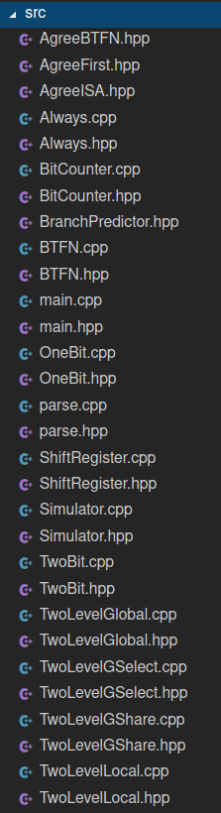
Code
Based of from HW4.
Modular code, allowing us to create new branch predictors without large changes.
Only change was make all the classes runtime constructable so we could change the various parameters without recompiling.
There were 2 relevant classes. The Simulator and the BranchPredictor interface.

Slide 9
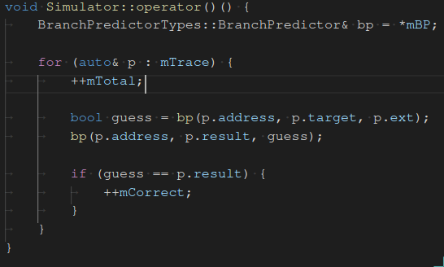
Simulator Class
Members
Pointer to a BranchPredictor
The parsed trace file
Predictor metrics
Code
Go through each line
Ask Branch predictor for guess
Update metrics if correct
Update BranchPredictor’s internal state

Slide 10
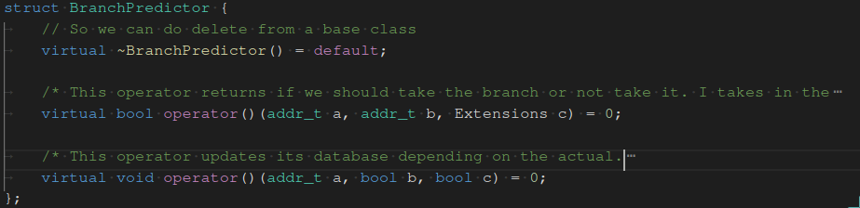
BranchPredictor Interface
The main interface of all branch predictors.
Two functions:
Ask the guess
Update internal data

Slide 11
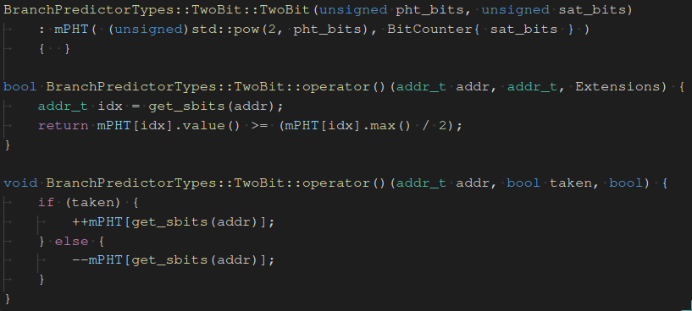
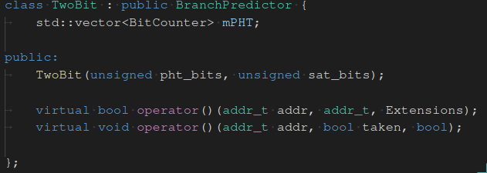
Example TwoBit
Implementation
Array of bit counters for the PHT indexing
C’tor to setup PHT and BitCounters
Update Interface
Increment PHT value if taken
Decrement otherwise
BitCounter takes care of over/underflow
C’tor
Create Array of BitCounters
Guess interface
Get SigBits of the address
Use it to index the PHT and get guess

Slide 12
Example TwoBit
Implementation
Array of bit counters for the PHT indexing
C’tor to setup PHT and BitCounters

Slide 13
Example TwoBit
C’tor
Create Array of BitCounters

Slide 14
Example TwoBit
Guess interface
Get SigBits of the address
Use it to index the PHT and get guess

Slide 15
Example TwoBit
Update Interface
Increment PHT value if taken
Decrement otherwise
BitCounter takes care of over/underflow

Slide 16
Agree Predictor
Saturation counter tells us how much do we “agree” with the bias.
If our bias is 1, our saturation counter could agree with it (take the branch), or disagree with it (not take the branch)
This bit could come from The First Time we come to the branch, ISA Extentions, or by BTFN
Should be in the direction it most likely goes in.

Slide 17
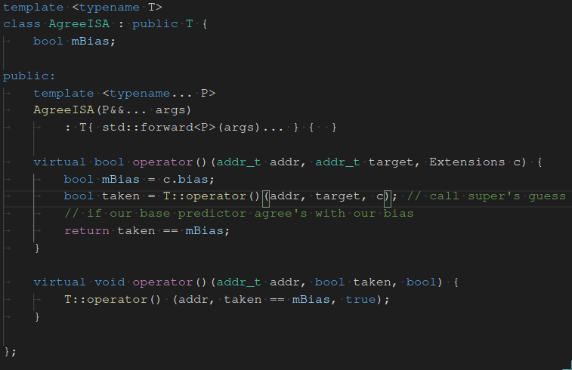
Agree Predictor Code
Guess interface
Store the bias
Ask the base predictor for prediction
See if we should agree with the bias using the base predictor’s guess
Templated class to reduce code redundancy.
One member, the bias for current branch we are predicting.
Agree predictor is build on top of other BP’s (inheritance of another BranchPredictor)
Update Interface
Update the base predictor if the result of the branch agreed with our bias
Stored bias as internal state because of this
Call Base class’s Update interface
C’tor
Forwards all arguments to base class (base predictor) using perfect forwarding
Notes:
We have one member variable, mostly because changing the BranchPredictor Interface would mean changing every other BranchPredictor child class

Slide 18
Agree Predictor Code
Templated class to reduce code redundancy.
One member, the bias for current branch we are predicting.
Agree predictor is built on top of other BP’s (inheritance of another BranchPredictor)

Slide 19
Agree Predictor Code
C’tor
Forwards all arguments to base class (base predictor) using perfect forwarding

Slide 20
Agree Predictor Code
Guess interface
Store the bias
Ask the base predictor for prediction
Check agreement with the bias using the base predictor’s guess

Slide 21
Agree Predictor Code
Update Interface
Update the base predictor if the result of the branch agreed with our bias
Stored bias as internal state because of this
Call Base class’s Update interface

Slide 22
First Time Agree Predictor Results

Slide 23
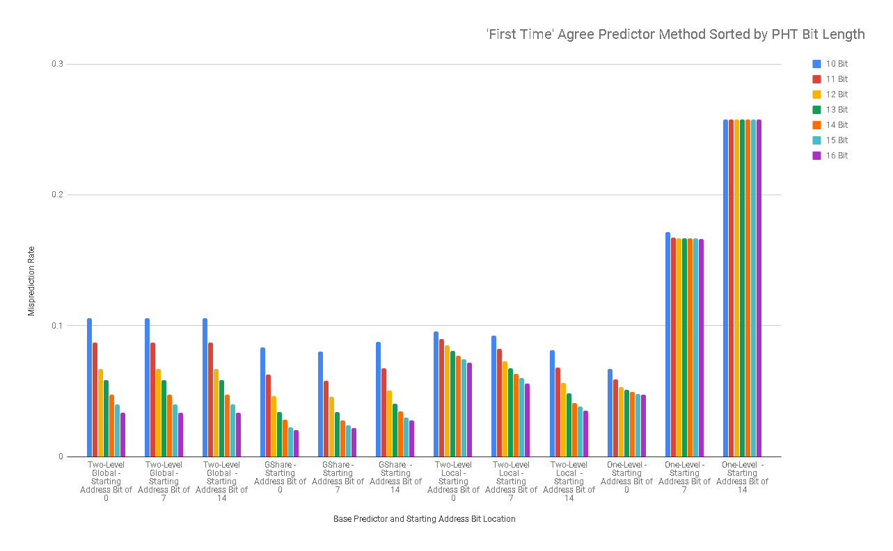
Here, we’re setting the bias bit to when the branch was first reached.

Slide 24
What should we keep in mind?
One-level predictions aren’t the best idea for using as a base predictor for the agree predictor implementation
Experimenting with starting address bits is a good idea, because optimizations can vary
A bigger PHT bit length is usually better
gShare prediction performs the best after optimization

Slide 25
Most Likely Agree Predictor Results

Slide 26
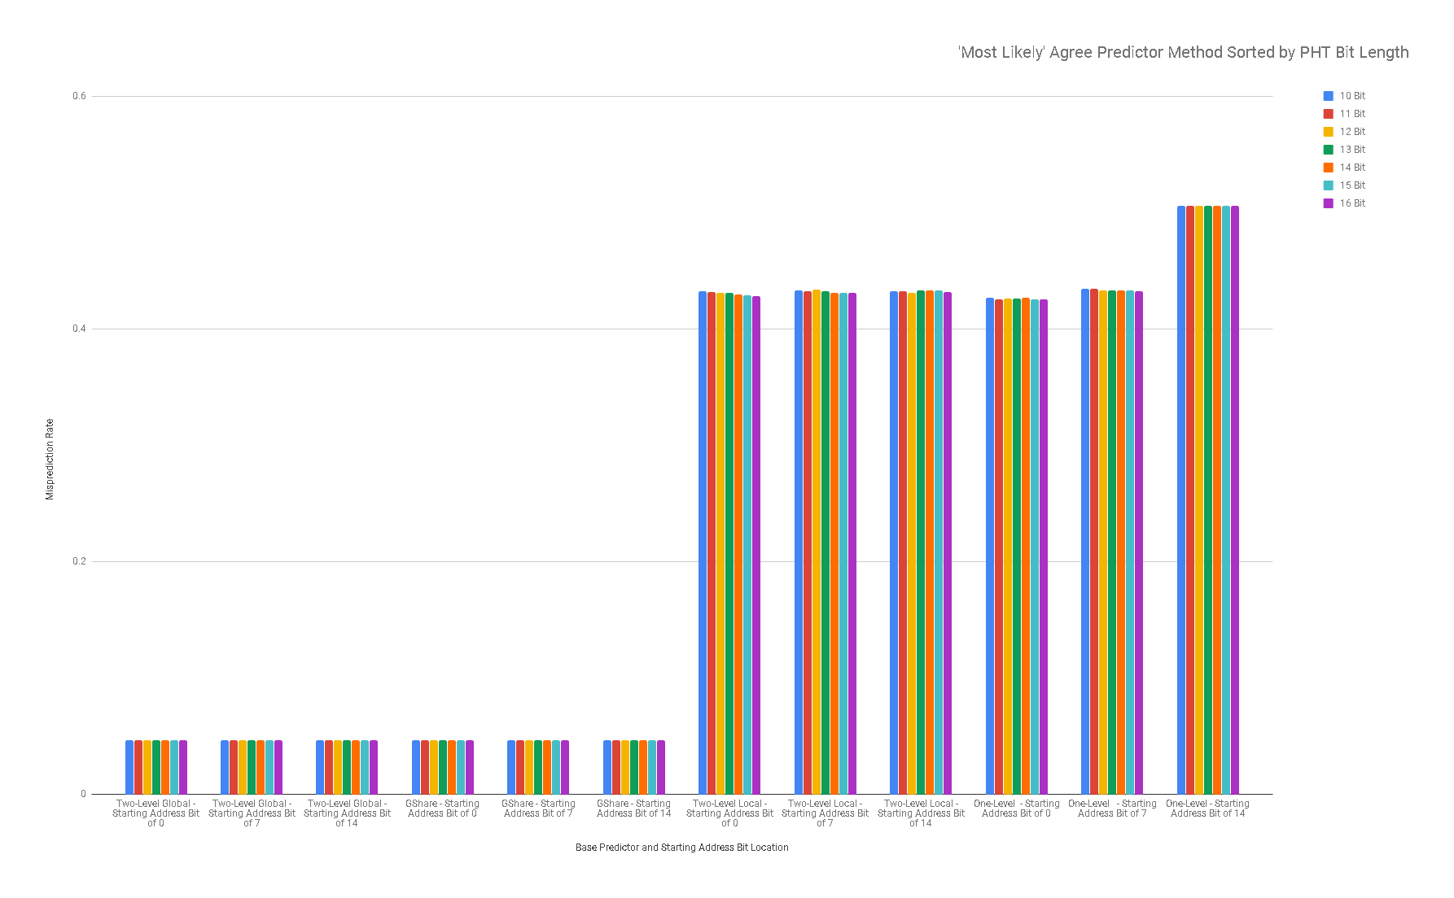
ISA extension modified after first run, with a biasing bit on the branch to note whether it was taken or not taken.

Slide 27
Results
The Two-Level Global and Gshare base predictors had the same rate of 95.33% of accurate prediction.
Both the One-Level and Two-Level Local base predictors accurate branch prediction rate is between 56-58%.
Any variation in the starting bit or the PHT table had very little change in the miss rate of the predictors with the exception of Two-Level Local and One-Level.
Exception, One-Level - Starting Address Bit location of 14 moves up to about 50% miss rate.

Slide 28
Backward Taken Forward Not Taken Agree Predictor Results

Slide 29
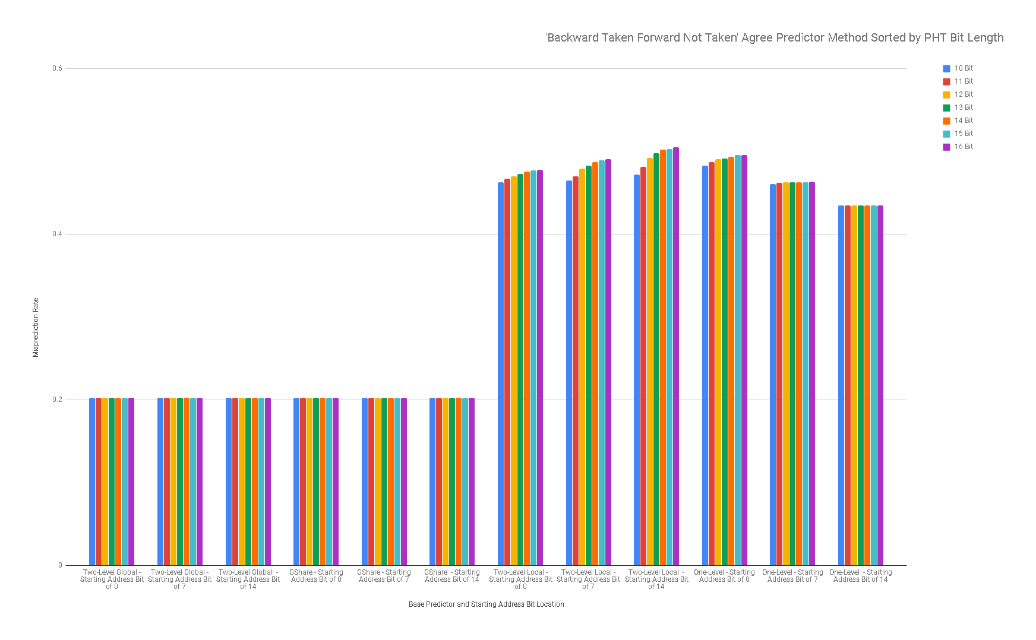

Slide 30
Results
Increasing the bits of the PHT did not alter the misprediction rate of Two-Level Global and Gshare base predictors.
One-Level and Two-Level Local base predictors get around a 40% misprediction rate.
Two-Level Local does not benefit from a larger PHT, in fact the misprediction gets worse.
Most likely agree predictor performed better on GShare and Two-Level Global.

Slide 31
References
E. Sprangle, R.S. Chappell, M. Alsup, and Y.N. Pat, “The Agree Predictor: A Mechanism For Reducing Negative Branch History Interference,” IEEE,,, June 1997.
“Branch prediction,” danluu. [Online]. Available: https://danluu.com/branch-prediction/. [Accessed: 13-Dec-2018].
H. Tabkhi, “Lecture-08-Branch Prediction.” UNCC, Charlotte, 03-Nov-2018.

Slide 32
Questions?

